Slide 1


Bindless Rendering in D3D12
NEXT SLIDE

Slide 2


Overview
Bindless Rendering
01
Shader model pre-6.6 & 6.6 bindless.
02
Rendering resource handles
03
Descriptor management.
04
Bindless shader code.
05
Bonus
‹#› | PAGE

Slide 3
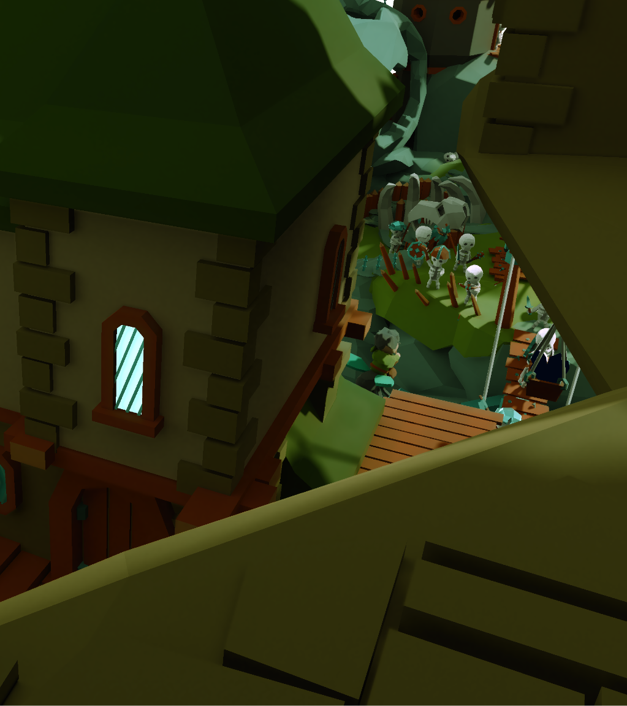
Bindless Rendering
Motivation
01
Significantly reduce API overhead.
02
Reduce rendering pipeline complexity.
03
Descriptor staging is a thing of the past.
04
Makes DXR 1.0 / 1.1 a lot easier to work with.
05
More lightweight rendering backend.
‹#› | PAGE

Slide 4
Traditional ”Bindfull” problems
Root Signatures
Descriptor Staging
Excessive API Calls
Each pipeline has a unique root signature.
Sometimes uses shader reflection.
A lot of management code and/or factories to make this all work.
Staging descriptors from a big heap on the cpu to smaller gpu heaps.
A lot of management code.
Difficult to track.
`CopyDescriptors` call per unique draw/dispatch.
`SetCompute/
SetGraphicsRootDescriptor` per unique draw/dispatch
The point of d3d12 is to have lower CPU overhead, let’s make it count!
‹#› | PAGE
Notes:
https://go.forrester.com/blogs/predictions-2021-privacy-becomes-an-imperative-in-a-year-of-transition
https://www.iab.com/insights/the-state-of-data-2020/
https://www.martechadvisor.com/news/customer-experience-2/89-customers-are-ready-to-share-their-data-in-exchange-of-loyalty-points-or-rewards-reports-cheetah-digital/
Factual, 2019 Consumers & Data Privacy Perceptions, August, 2019, https://s3.amazonaws.com/factual-content/marketing/downloads/Factual-Consumers-Data-Privacy-Perceptions-Report.pdf

Slide 5
Bindless Rendering
Setting up bindless heaps
A single shader visible descriptor heap for all CBV_SRV_UAV descriptors and optionally SAMPLER.
Non-shader visible heaps still required for RTV and DSV.
CBV_SRV_UAV descriptor heap can go up to 1,000,000+ descriptors
SAMPLER heap is limited (2048) on most hardware.
Make sure to check out hardware tiers. We assume hardware tier 3 for our framework “Breda”.
Bindless Everything
‹#› | PAGE

Slide 6
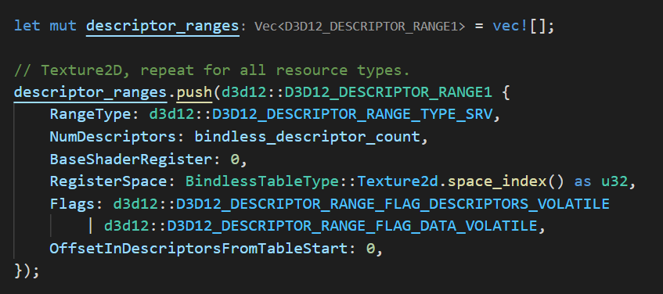
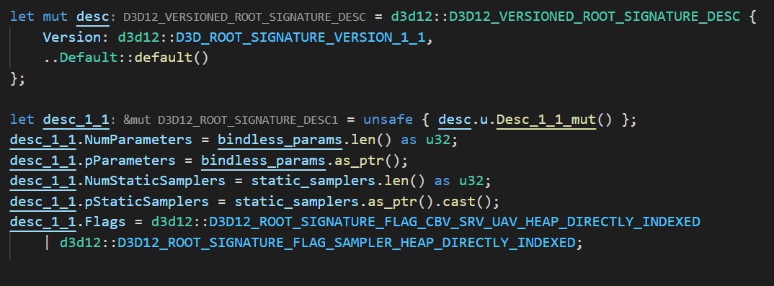
Shader model 6.5 or lower
Bindless Rendering
A “global” root signature.
A single root signature for all shaders.
Assign register space per resource type.
Set up root constants.
Set up static samplers.
Shader model 6.6+
‹#› | PAGE

Slide 7
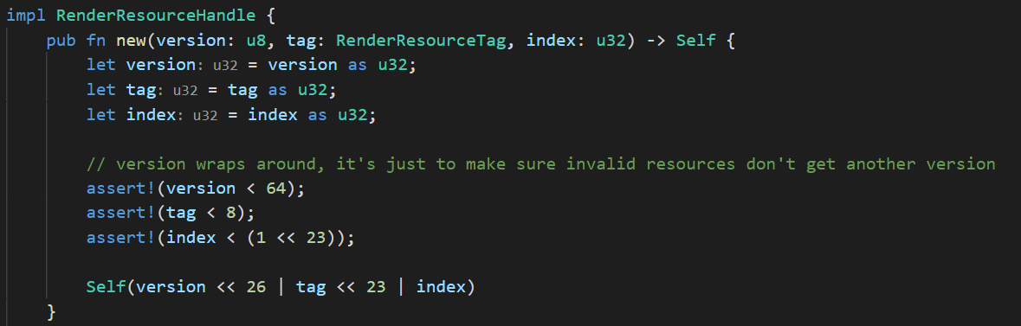
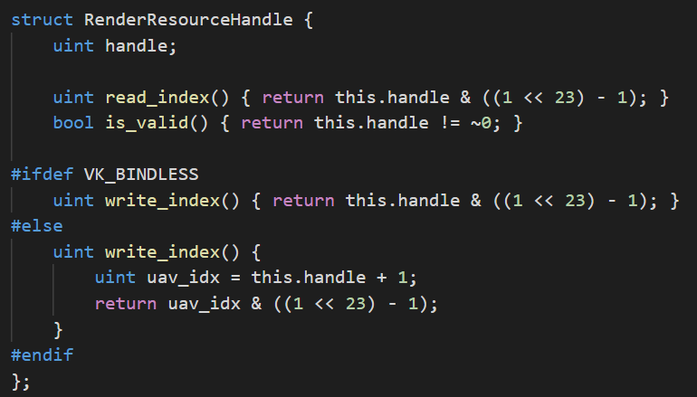
Cpu implementation
Bindless Rendering
Rendering resource handles
A RenderResourceHandle maps 1:1 to an index in our bindless descriptor heap.
RenderResourceHandle is simply a uint32 but we are not using all 32 bits, unused bits can be used for validation purposes.
RenderResourceHandles are exclusively created during resource creation.
What about SRV & UAV as they are separate descriptors?
HLSL
‹#› | PAGE

Slide 8
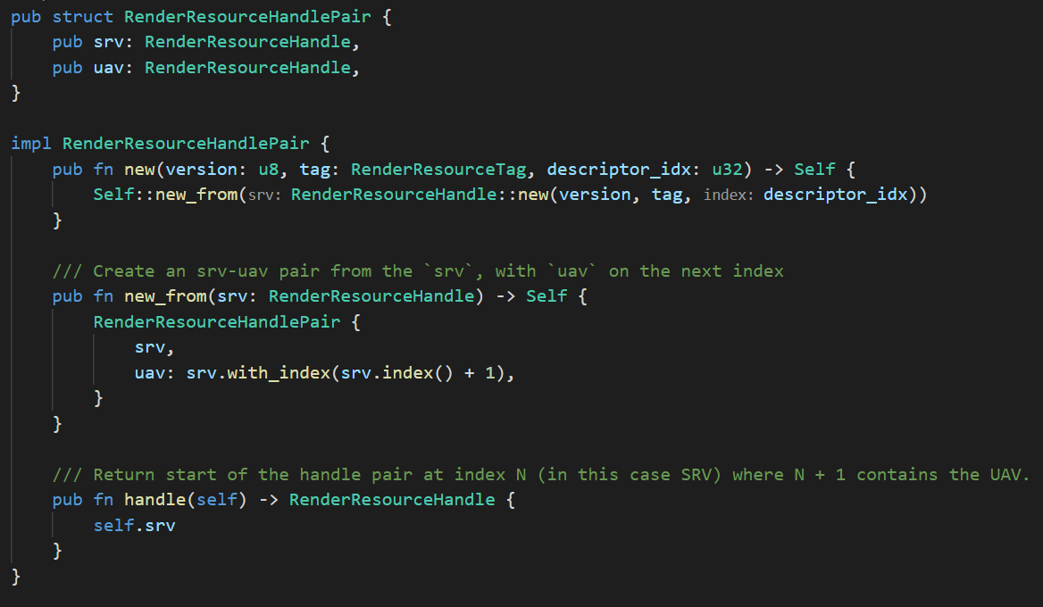
Bindless Rendering
implementation
Rendering resource handles
Introduction of RenderResourceHandlePair
SRV & UAV descriptors are assumed at index
{ [n], [n+1] }
Each (sub)resource has a RenderResourceHandlePair
‹#› | PAGE

Slide 9
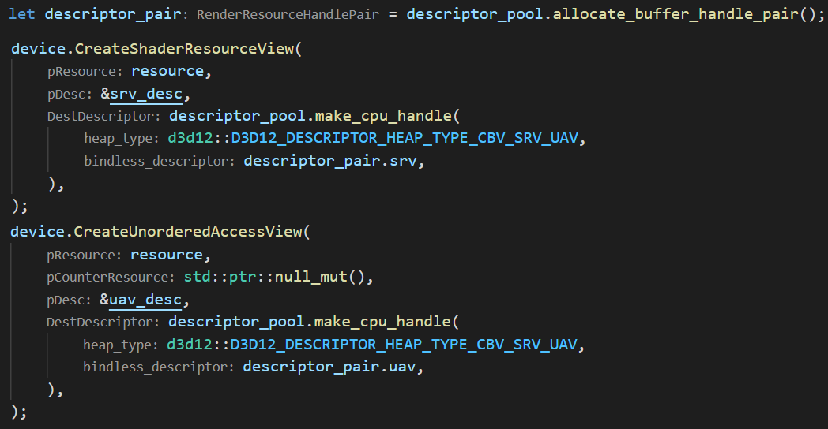
Bindless Rendering
Views created during resource init
Rendering resource handles
Each resource has a RenderResourceHandlePair, additionally Render targets/Depth stencils may have additional RTV / DSV handles in their according heap types.
Create the views once during resource creation.
‹#› | PAGE

Slide 10
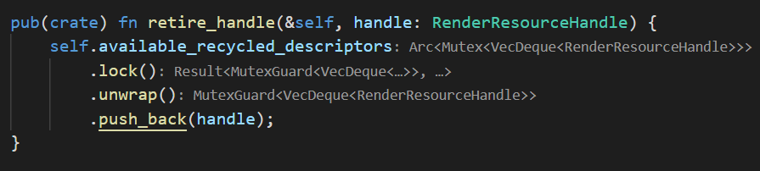
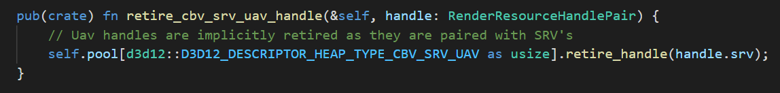
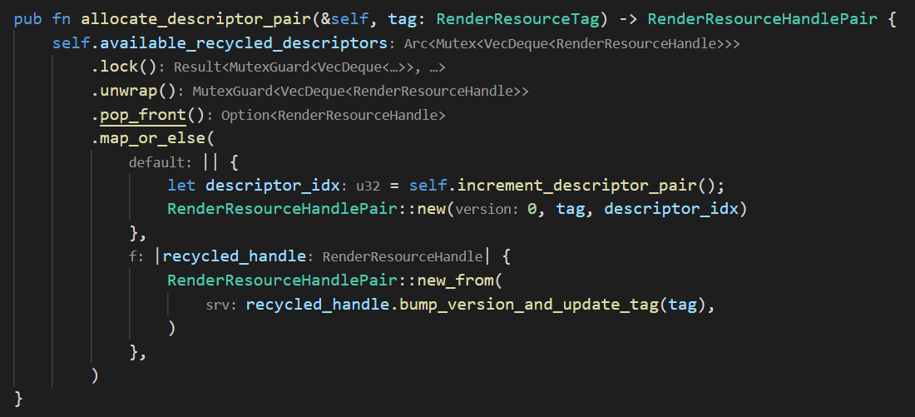
Bindless Rendering
Resource handle management
Upon dropping resources, recycle the descriptor.
Upon allocating RenderResourceHandlePairs, check for recycled handles.
RenderResourceHandlePairs are recycled in FIFO order.
Permanent fragmentation may occur if FIFO order is not respected.
Only recycle descriptors when they are no longer in use!

Slide 11
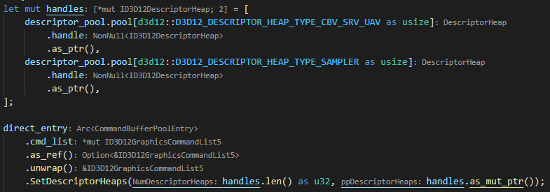
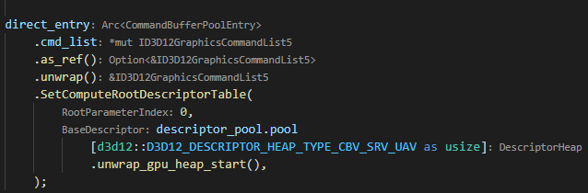
Bind heaps
Bindless Rendering
Preparing for bindless rendering
01
Set descriptor heaps.
Set descriptor tables (sm6.5)
02
Set graphics/compute root signatures.
03
(sm6.5) bind descriptor tables.
‹#› | PAGE

Slide 12
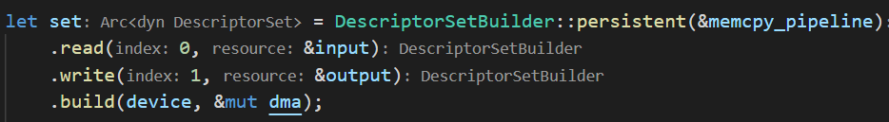
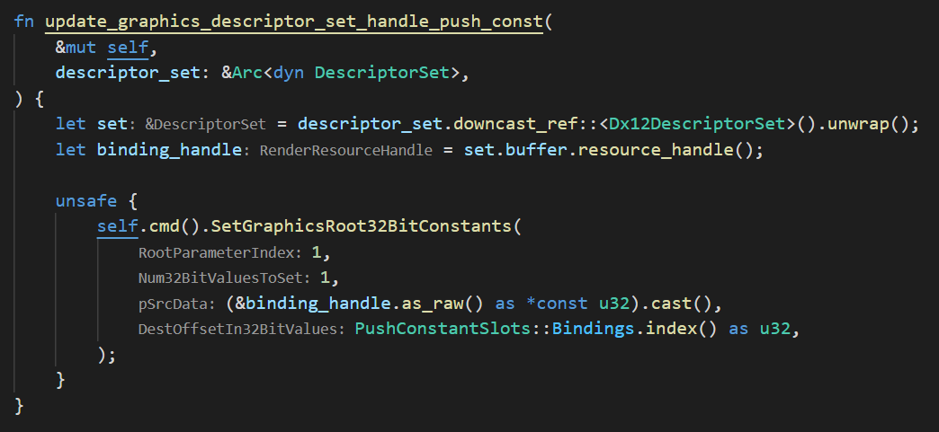

Bindless Rendering
Descriptor sets
Build buffer with render handles
01
Create a buffer containing RenderResourceHandles.
02
The created buffer has a RenderResourceHandle.
Set handle with push constant
03
Set root constant with the handle of the created buffer.
‹#› | PAGE

Slide 13
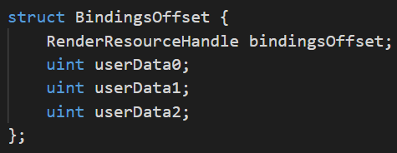
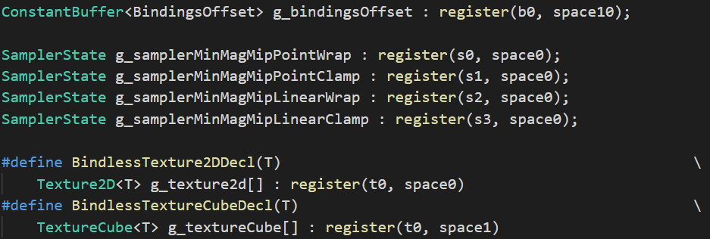
root constants
Bindless Rendering
Declaration of all resources
Shader model 6.5 bindless shaders
04
Load bindings in shader.
05
Dynamically index in descriptor heap.
Dynamic indexing 6.5
Dynamic indexing 6.6
‹#› | PAGE

Slide 14
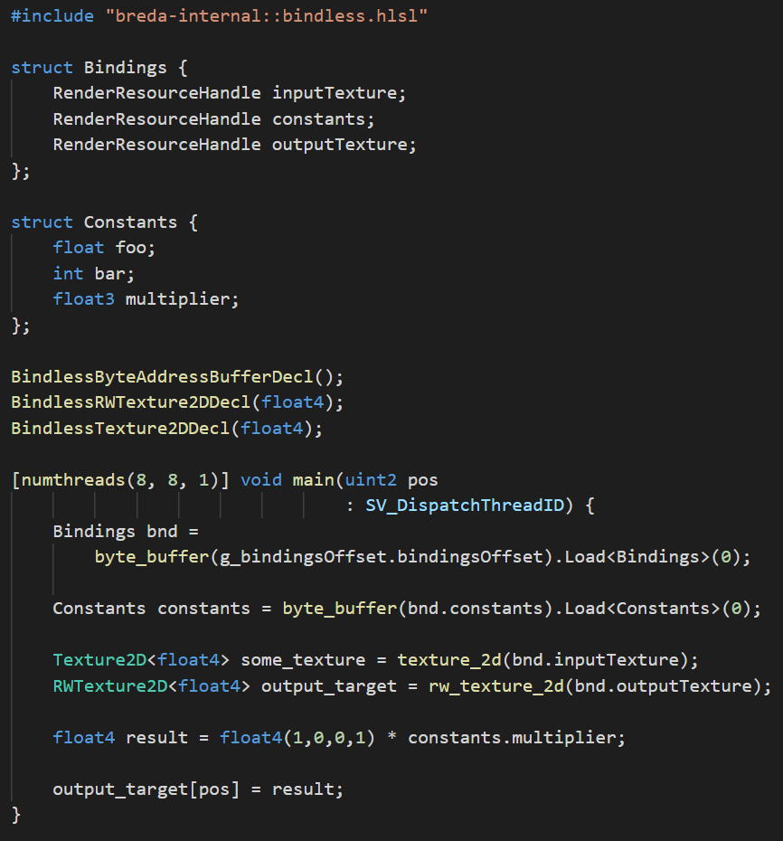
Bindless Rendering
Bindless shader example
pre-sm6.6 approach is forced to use declarations and functions for dynamic indexing.
We only use (RW)ByteAddressBuffers for buffer types, templated load and store helps a lot.
Still not ideal, sm6.6 template approach is ideal.
‹#› | PAGE

Slide 15
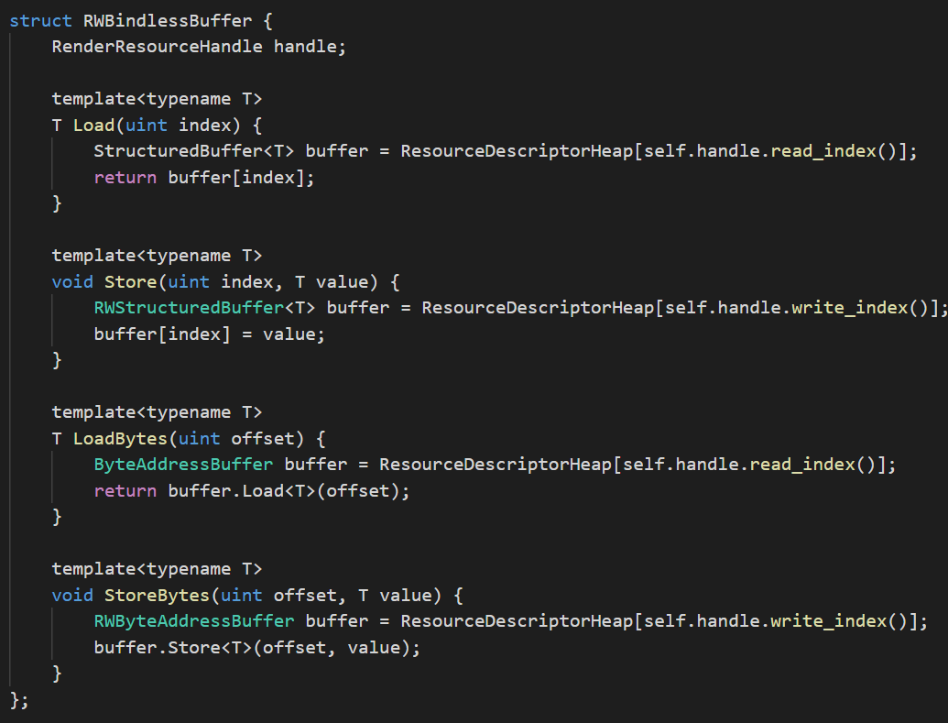
Bonus Slide
Future directions with templating
More specialized RenderHandles with the use of templates.
‹#› | PAGE

Slide 16

THANK YOU

